Slide 1
English 8-Chapter 8
Exercise 5
Combining by Inserting Words

Slide 2
1
The Empire State Building was constructed in one year and forty-five days. The Empire State Building was once the tallest building in the world.
Once the tallest building in the world, the Empire State Building was constructed in one year and forty-five days.

Slide 3
2
The building cost over twenty-four million dollars to complete. The building was a gigantic structure.
A gigantic structure, the building cost over twenty-four million dollars to complete.
The building, a gigantic structure, cost over twenty-four million dollars to complete.

Slide 4
3
The building is a popular tourist attraction. It weighs 365 million tons and contains 102 floors. (Change weighs to weighing and contains to containing.)
The building is a popular tourist attraction weighing 365 million tons and containing 102 floors.

Slide 5
4
The building was the site of a tragic event. The event occurred in 1945.
The building was the site of a tragic event in 1945.

Slide 6
5
An Army B-25 cargo plane crashed into the seventy-ninth floor, killing fourteen people. The plane flew through heavy fog. (Change flew to flying).
An Army B-25 cargo plane flying through heavy fog crashed into the seventy-ninth floor, killing fourteen.

Slide 7
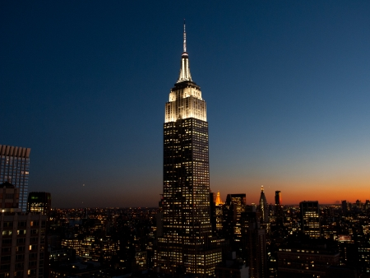
End

